Slide 1
Neonatal Sepsis
DEPARTEMENT OF PEDIATRICS AND CHILD HEALTH
By: Dr.Mesfin.W(Assistant professor of Pediatrics and child health)
November @2023

Slide 2
Outline
Terminologies
Introduction
Epidemiology and Pathogenesis
Etiology
Clinical presentations
Diagnosis and management
References

Slide 3
Objectives
Review of terminologies associated with neonatal infections
Review risk factors and pathophysiology of neonatal infections
Understand presentations of neonatal sepsis
Review most common organisms and treatments of neonatal sepsis

Slide 4
Terminologies
Neonatal period-is the first 28 day of life, and also classified as
  1. Early neonatal period ( the first 7 days)
  2. Late neonatal period (from day 8 to 28 days)
Perinatal period- the period from 28 weeks of gestation to 7 days postnatal
Prenatal period- the period from 28 weeks of gestation to birth
Postnatal period- the period after birth

Slide 5
Introduction
Infections in the newborn are often classified by their timing relative to birth and include
    Congenital
    Perinatal
    Early-onset, and
    Late-onset disease.
Congenital or intrauterine infections…..are those transmitted across the placenta
perinatal infection …. those transmitted from the mother to the fetus or newborn infant during the birth process.
Notes:
These are clinically useful designations because
the mechanisms of infection,
etiologies, and
outcomes are distinct at each stage.
Infections are a frequent and important cause of neonatal morbidity and mortality.
Congenital or intrauterine infections (i.e., those transmitted across the placenta) and
perinatal infections (i.e., those transmitted from the mother to the fetus or newborn infant during the birth process) represent 2 major routes of neonatal infection.

Slide 6
Unique characteristics of neonatal infections
Transmission from the mother occurs via diverse modes
Maternal infections are often not diagnosed during pregnancy (asymptomatic, non-specific)
Etiologies are different (bacteria, fungi, virus, protozoa)
Immature immunity
Comorbid conditions complicate Dx & Mx of infections
c/ms are variable (subclinical, mild to severe, focal/systemic, malformations) depending on :
  Timing of exposure
  Inoculum size
  Immune status
  Virulence of organisms
Notes:
Newborn infants are less capable of responding to infection because of one or more immunologic deficiencies

Slide 7
WHY All neonates are susceptible to infection?
➢ The immaturity of a neonate’s immune system makes them MORE SUSCEPTIBLE to sepsis.
Notes:
The immaturity of a neonate’s immune system makes them MORE SUSCEPTIBLE to sepsis.

Slide 8
Immunologic deficiencies
The immune system can be divided into 4 different parts:
1. Antibodies (immunoglobulins) - which damage organisms and attract phagocytic cells.
2. Lymphocytes - produce antibodies & kill organisms.
3. Phagocytic cells – (macrophages and polymorphs), that ingest and kill organisms.
4. Complement - a group of proteins that help antibodies to damage organisms and attract phagocytic cells.

Slide 9
WHY DO NEWBORN INFANTS OFTEN BECOME INFECTED?
Antibodies
1. The antibodies IgA and IgM are too big to cross the placenta from the mother. But, during the first 6 months of life the infant gradually produces its own IgA and IgM.
2. IgG does cross the placenta but mostly crosses in the last weeks of pregnancy. Preterm infants, therefore, have very little IgG. After birth the infant starts to produce its own
IgG as the amount of maternal IgG decreases.

Slide 10
WHY DO NEWBORN INFANTS OFTEN BECOME INFECTED?
Lymphocytes, Phagocytic cells, Complements
3. All infants have immature lymphocytes. A mature lymphocyte needs previous contact with a specific organism before it is able to recognise and kill it.
4. The phagocytic cells are present in all infants but they do not function normally due to the low concentrations of complement.
5. Low complement concentrations in (especially if preterm) prevents the phagocytes from functioning normally.

Slide 11
What makes a neonate’s immune system immature?
Pathogen enters body
Normally an immune system responds to a pathogen in a specific manner, but if there are problems with any element the immune system is unable to function properly.
Neutrophils move in
Chemotaxis occurs
Opsonization causes
phagocytosis
Monocytes kill pathogen
Notes:
Normally an immune system responds to a pathogen in a specific manner, but if there are problems with any element the immune system is unable to function properly [3&6].

Slide 12
Susceptibility of the newborn to infection
Related to immaturity of both the cellular and humoral immune systems at birth.
  Decreased function of neutrophils
  Neonatal T cells appear to be relatively deficient in most of their major function
  Low concentrations of immunoglobulin (preterm)
Notes:
The immaturity of a neonate’s immune system makes them MORE SUSCEPTIBLE to sepsis.
Neutrophils: An important cell in immunity against pathogens

Slide 13
Conti….
Quantitative and qualitative defects of complement system ( both term & preterm)
In premature newborns cord IgG levels are directly proportional to GA.
IgA is virtually absent at birth ( usually <5mg/dl)
Newborn usually lack antibody mediated protection against Escherichia coli & other Enterobacteriaceae. ( Because no IgM is transferred to fetus)
Notes:
Complement system:-
mediates bactericidal activity against certain organisms such as E. coli .
functions as an opsonin with antibody in the phagocytosis of bacteria such as GBS.
No transplacental passage of complement from the maternal circulation.
slightly diminished classical and moderately diminished alternative complement pathway activity.

Slide 14
General Approach
The general approach includes a detailed maternal history
Comprehensive physical examination.
laboratory testing ….. to establish a specific microbiologic etiology and guide management decisions.
Notes:
The general approach includes a detailed maternal history ,,,,Review of the pregnancy, labor, and delivery, including risk factors for sepsis and the use and duration of maternal intrapartum antibiotic prophylaxis (IAP).
Comprehensive physical examination.
laboratory testing is usually required to establish a specific microbiologic etiology and guide management decisions.
The general approach is similar to that for congenital infections and includes a detailed maternal history and a careful examination of the newborn.
Many clinical syndromes overlap, and therefore laboratory testing is usually required to establish a specific microbiologic etiology and guide
management decisions.

Slide 15
Epidemiology & pathogenesis
Important causes of neonatal morbidity & mortality.
2% of fetuses are infected in utero, and
up to 10% of infants have infections in the 1st mo of life.
ROUTES OF INFECTION
    1.Transplacentally
    2. Ascending Infection/ Intrapartum
    3. Postnatally
Notes:
mode of Transmission:-mainly 2 routes
hematogenous infection(transplacental route) and ascending infections
EPIDEMIOLOGY — The overall incidence of neonatal sepsis ranges from 1 to 5 cases per 1000 live births. Estimated incidence rates vary based on the case definition and population studied. In a systematic review and meta-analysis of population-based studies from around the world, the estimated pooled incidence of neonatal sepsis was 22 per 1000 live births, with an associated mortality rate of 11 to 19 percent
Rates of neonatal sepsis increase with decreasing gestational age:
●Term neonates (≥37 weeks gestational age) – The estimated incidence of sepsis (both early- and late-onset) in term neonates is 1 to 2 cases per 1000 live births
Late preterm neonates (34 through 36 weeks gestational age) – The incidence is higher in late preterm than term neonates.

Slide 16
Pathogenesis of ascending infections
The human birth canal is colonized with aerobic and anaerobic organisms may result in ascending amniotic infection and/or colonization of the neonate at birth
Bacterial vertical transmission occurs while in utero or more commonly during labour or delivery.
Notes:
The fetus or neonate is not exposed to potentially pathogenic bacteria until the membranes rupture and the infant passes through the birth canal.
The human birth canal is colonized with aerobic and anaerobic organisms that may result in ascending amniotic infection and/or colonization of the neonate at birth
Bacterial vertical transmission occurs while in utero or more commonly during labour or delivery.
Ascending amniotic infection may occur with either apparently intact membranes or relatively brief duration of membrane rupture.
Infectious agents can also be acquired as the newborn infant passes through the vaginal canal. This acquisition may result in either colonization or disease.
Factors influencing which colonized infants will experience disease are not well understood but include prematurity, underlying illness, invasive procedures, inoculum size, virulence of the infecting organism, genetic predisposition, the innate immune system, host response, and transplacental maternal antibodies.

Slide 17
Conti….
Bacterial colonization does not always result in disease.
In the absence of Intrapartum antibiotics prophylaxis, approximately 50% of infants born to mothers colonized with GBS are found to be colonized with this organism at birth.
Approximately 1% to 2% of all colonized infants develop invasive GBS disease.
Notes:
In the absence of
IAP, approximately 50% of infants born to mothers colonized with
GBS are found to be colonized with this organism at birth. Approximately 1% to 2% of all colonized infants develop invasive GBS disease, with clinical factors such as gestational age and duration of ROM contributing to risk for any individual infant

Slide 18
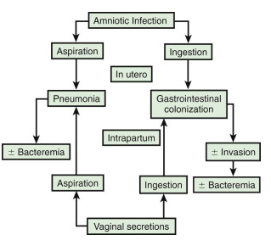
Pathogenesis of ascending infections
Notes:
Amniotic infection results from microbial invasion of amniotic fluid, usually as a result of prolonged ROM
May be asymptomatic or produce maternal fever with/without local /systemic sign of chorioamnionitis

Slide 19
Conti…
Factors that increase risk of infection:
  Prolonged ROM (>18hrs)
  Untreated maternal urinary/GI infection
  Instrumental delivery
  Umbilical catheterization
  Prolonged labor
Factors that increase development of disease from infection:
  Prematurity
  Low birth-weight
  Underlying illnesses
  Inoculum size
  Virulence of the organism
  the innate immune system,
  host response, and transplacental maternal antibodies .

Slide 20
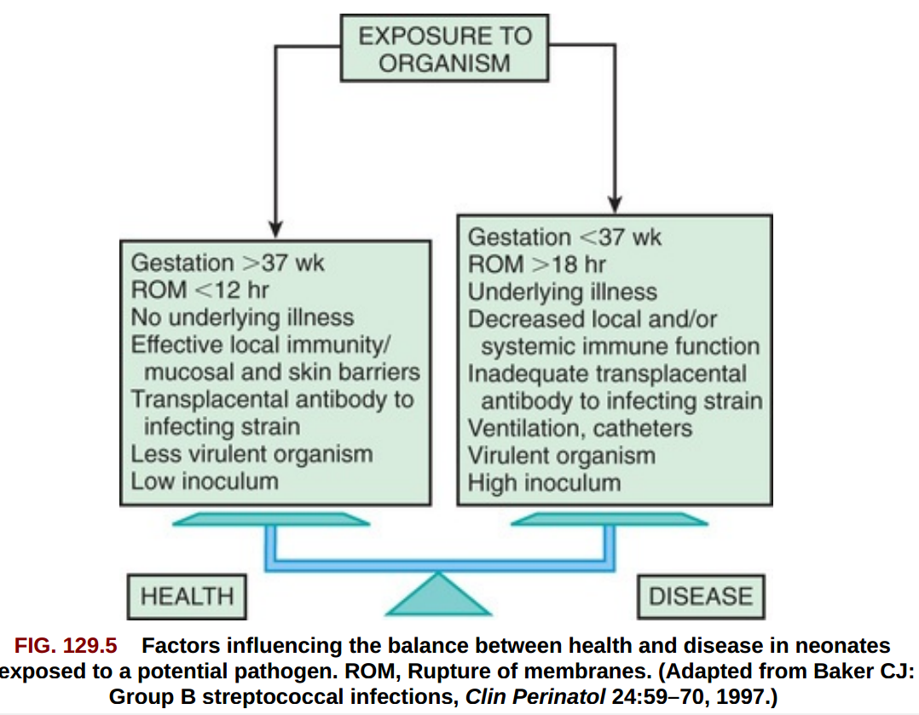
Conti…..
Aspiration of infected amniotic fluid leads to congenital pneumonia or systemic infection manifesting at:-
  Before delivery (fetal distress, tachycardia)
  At delivery (PNA)
  After delivery (respiratory distress, shock)
Colonization during labour or delivery leads to infection within 1-2 days after exposure

Slide 21
Etiology of perinatal infections
Any microorganism inhabiting the GUT or lower GIT may cause intrapartum and postpartum infection.
Most common bacteria:-GBS, enteric organisms(E.coli,Kleibsella), gonococci, and chlamydia
Common viruses:-CMV, HSV, enteroviruses, and HIV.

Slide 22
Cont’d…
Etiology for Pneumonia:-GBS, gram-negative enteric aerobes, L. monocytogenes, Mycoplasma spp, C. trachomatis, CMV, HSV, and Candida species.
Most common etiology for neonatal meningitis:-GBS, E. coli, and L. monocytogenes.
Others:-S. pneumoniae, other streptococci, non-typable H.influenzae, both coagulase-positive and coagulase-negative staphylococci, Klebsiella,etc

Slide 23
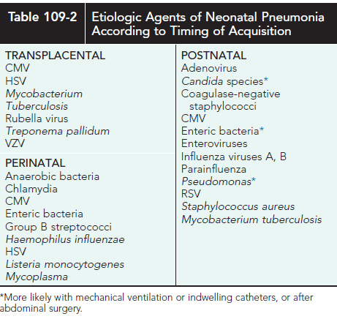

Slide 24
Neonatal sepsis
Neonatal sepsis is a clinical syndrome in an infant 28 days of life or younger, manifested by systemic signs of infection and isolation of a bacterial pathogen from the bloodstream. A consensus definition for neonatal sepsis is lacking
Notes:
Neonatal sepsis is a a clinical syndrome characterized by systemic signs of infection, accompanied by bacteremia in the first month of life.
Early-onset sepsis — Early-onset infection is usually due to vertical transmission by ascending contaminated amniotic fluid or during vaginal delivery from bacteria colonizing or infecting the mother's lower genital tract. The risk for sepsis increases from 1 to 4 percent in neonates born to mothers with chorioamnionitis.
Maternal group B streptococcal (GBS) bacteriuria during the current pregnancy, prior delivery of an infant with GBS disease, and maternal colonization are some risk factors for early-onset GBS sepsis
Late-onset sepsis — Late-onset infections can be acquired by the two following mechanisms:
Maternal vertical transmission, resulting in initial neonatal colonization that evolves into later infection.
Horizontal transmission from direct contact with care providers or environmental sources (ie, health care-associated infections). Disruption of the intact skin or mucosa, which can be due to invasive procedures (eg, intravascular catheter), increases the risk of late-onset infection.

Slide 25
Classification
Early-onset sepsis.. is defined as the onset of symptoms before 7 days of age.
  is usually due to vertical transmission by ascending contaminated amniotic fluid or during vaginal delivery from bacteria colonizing or infecting the mother's lower genital tract.
Late-onset sepsis…. is defined as the onset of symptoms at ≥7 days of age.
  Maternal vertical transmission, resulting in initial neonatal colonization that evolves into later infection.
  Horizontal transmission from direct contact with care providers or environmental sources.
Late-late onset neonatal sepsis/Very-late-onset sepsis.. (onset after age 1 mo.)
  Source of infection=environment & community
Notes:
The terms early-onset infection and late-onset infection refer to the different ages at onset of infection in the neonatal period.
Early-onset sepsis is defined as the onset of symptoms before 7 days of age, although some experts limit the definition to infections occurring within the 1st 72 hr of life.
Late-onset sepsis is generally defined as the onset of symptoms at ≥7 days of age. Similar to early onset sepsis, there is variability in the definition, ranging from an onset at >72 hr of life to ≥7 days of age.
Early-onset infections are acquired before or during delivery (vertical mother-to-child transmission).
Late-onset infections develop after delivery from organisms acquired in the hospital or the community.
The age at onset depends on the timing of exposure and virulence of the infecting organism.
Very-late-onset infections (onset after age 1 mo.) may also occur,particularly in very-low-birthweight (VLBW) preterm infants or term infants
requiring prolonged neonatal intensive care.

Slide 26
Risk factors
1.Prematurity:-
possible explanation
a. maternal genital tract infection is considered to be an important cause of preterm labor.
b. the frequency of intra-amniotic infection is inversely related to GA.
c. premature infants have documented immune dysfunction.
d. prolonged hospitalization predisposing for nosocomial infection
Notes:
Neonates are uniquely prone to invasive disease because of their lack of fully
responsive innate immunity.
Attenuated immune responses often result in minimal or nonspecific clinical manifestations, and effective treatment requires attention to subtle signs of infection.
Compared to older infants, newborns are often treated empirically while awaiting results of laboratory investigations.
Preterm infants are particularly susceptible to infection because of their
decreased innate immune and barrier defenses and
their prolonged stay in hospital settings.

Slide 27
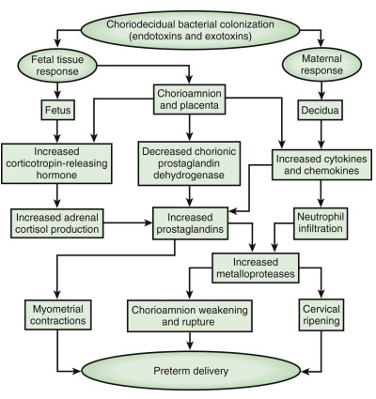
Potential pathways from chorio-decidual bacterial colonization to preterm delivery
Notes:
Studies suggest that term male infants have a higher incidence of sepsis than term females.
This sex difference is less clear in preterm low birthweight (LBW) infants.
The most important neonatal factor predisposing to infection is prematurity or LBW. Preterm LBW infants have a 3- to 10-fold higher incidence of infection than full-term normal-birthweight infants. Possible explanations include
(1) maternal genital tract infection is considered to be an important cause of preterm labor, with an increased risk of vertical transmission to the newborn;
(2) the frequency of intraamniotic infection is inversely related to gestational age;
(3) premature infants have documented immune dysfunction; and
(4) premature infants often require prolonged intravenous access, endotracheal intubation, or other invasive procedures that provide a portal of entry or impair barrier and clearance mechanisms, putting them at continued risk for hospital-acquired infections.

Slide 28
Risk factors…EONS
Intrapartum maternal temperature ≥38°C (100.4°F)
Delivery at <37 weeks gestation
Chorioamnionitis
Five-minute Apgar score ≤6
Evidence of fetal distress
Maternal GBS colonization
Membrane rupture ≥18 hours
Notes:
Risk factors for all neonates — The following maternal and neonatal risk factors, regardless of gestational age, are associated with neonatal sepsis and are discussed in greater detail separately. These factors are particularly pertinent to group B streptococcal (GBS) infection. (
Intrapartum maternal temperature ≥38°C (100.4°F)
Delivery at <37 weeks gestation
Chorioamnionitis
Five-minute Apgar score ≤6 [20]
Evidence of fetal distress
Maternal GBS colonization
Membrane rupture ≥18 hours – The risk of proven sepsis increases tenfold to 1 percent when membranes are ruptured beyond 18 hours

Slide 29
Conti…
Chorioamnionitis results from microbial invasion of amniotic fluid, but is now better defined by the term intrauterine inflammation or infection at birth (Triple I) .
Amniotic infection may also occur with apparently intact membranes or with a relatively brief duration of membrane rupture.
Chorioamnionitis may also be asymptomatic, diagnosed only by amniotic fluid analysis or pathologic examination of the placenta.
Notes:
Chorioamnionitis was thought to result from infection of the amniotic fluid
but is now better defined by the term intrauterine inflammation or infection at birth (Triple I) . Rupture of membranes for >24 hr was once considered prolonged because microscopic evidence of inflammation of the membranes is uniformly present when the duration of rupture exceeds 24 hr.
At 18 hr of membrane rupture, however, the incidence of early-onset disease with group B streptococcus (GBS) increases significantly; 18 hr is the appropriate cutoff for increased risk of neonatal infection.
Chorioamnionitis results from microbial invasion of amniotic fluid, often as a result of prolonged rupture of the chorioamniotic membrane.
Amniotic infection may also occur with apparently intact membranes or with a relatively brief duration of membrane rupture.
The term chorioamnionitis refers to the clinical syndrome of intrauterine infection, which includes maternal fever, with or without local or systemic signs of chorioamnionitis (uterine tenderness, foul smelling vaginal discharge/amniotic fluid, maternal leukocytosis, maternal and/or fetal tachycardia).
Chorioamnionitis may also be asymptomatic, diagnosed only by amniotic fluid analysis or pathologic examination of the placenta. The rate of histologic chorioamnionitis is inversely related to gestational age at birth (Fig. 129.4 ) and directly related to duration of membrane rupture.

Slide 30
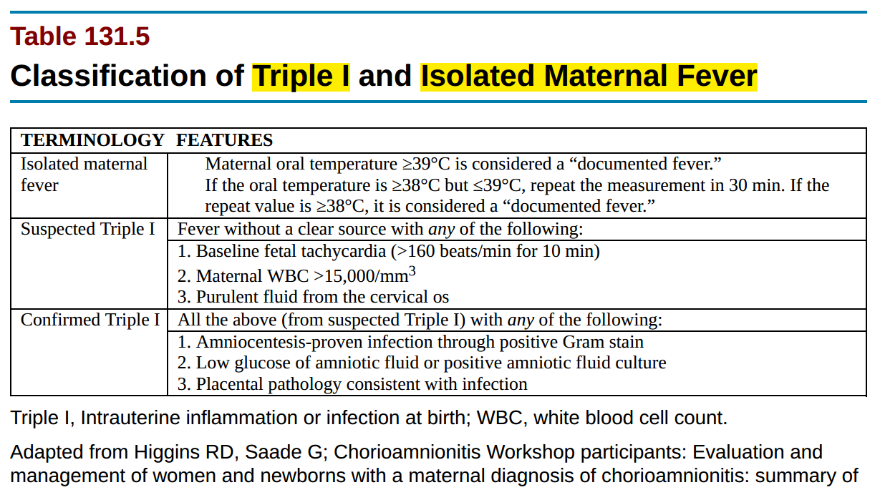
Notes:
Chorioamnionitis has been historically used to refer to microbial invasion of the amniotic fluid, often as a result of prolonged rupture of the chorioamniotic
membrane for >18 hr. The term chorioamnionitis is confusing because it does not convey the spectrum of inflammatory or infectious diseases, it leaves out
other intrauterine components that can be involved (e.g., decidua), and it results in significant variability in clinical practice, with the potential for a significant
number of well newborns being exposed to antimicrobial agents.
The term intrauterine inflammation or infection at birth , abbreviated as Triple I , has become more accepted because of the heterogeneous nature of conditions that can affect the mother and neonate. Regardless of the definition used, prematurity (<37 wk) is associated with a greater risk of early-onset sepsis, especially with group B streptococcus.

Slide 31
Conti….
Intrapartum antibiotics are used to reduce vertical transmission of GBS as well as to lessen neonatal morbidity after preterm rupture of membranes.
Intrapartum chemoprophylaxis does not reduce the rates of late-onset GBS disease and has no effect on the rates of infection with non-GBS pathogens.
Notes:
Intrapartum antibiotics are used to reduce vertical transmission of GBS as well as to lessen neonatal morbidity after preterm rupture of membranes.
Intrapartum chemoprophylaxis does not reduce the rates of late-onset GBS disease and has no effect on the rates of infection with non-GBS pathogens. Of concern is a possible increase in gram-negative infections (especially E. coli) in VLBW and possibly term infants in spite of a reduction in early GBS sepsis by intrapartum antibiotics.

Slide 32
Late-Onset Infections
After birth, neonates are exposed to infectious agents in the neonatal intensive care unit (NICU), the nursery, or in the community (including family).
Postnatal infections may be transmitted by direct contact with hospital personnel, the mother, or other family members; from breast milk (HIV, CMV); or from inanimate sources such as contaminated equipment.
The most common source of postnatal infections in hospitalized newborns is hand contamination of health care personnel, underscoring the importance of handwashing.

Slide 33
Conti…
The incidence of meningitis is 0.2-0.4/1,000 live births in newborn infants and is higher in preterm infants. Bacterial meningitis may be associated with sepsis or may occur as a local meningeal infection.
Up to one-third of VLBW infants with late-onset meningitis have negative blood culture results.
The discordance between results of blood and cerebrospinal fluid (CSF) cultures suggests that meningitis may be underdiagnosed among VLBW infants and emphasizes the need for culture of CSF in VLBW infants when late-onset sepsis is suspected and in all infants who have positive blood culture results

Slide 34
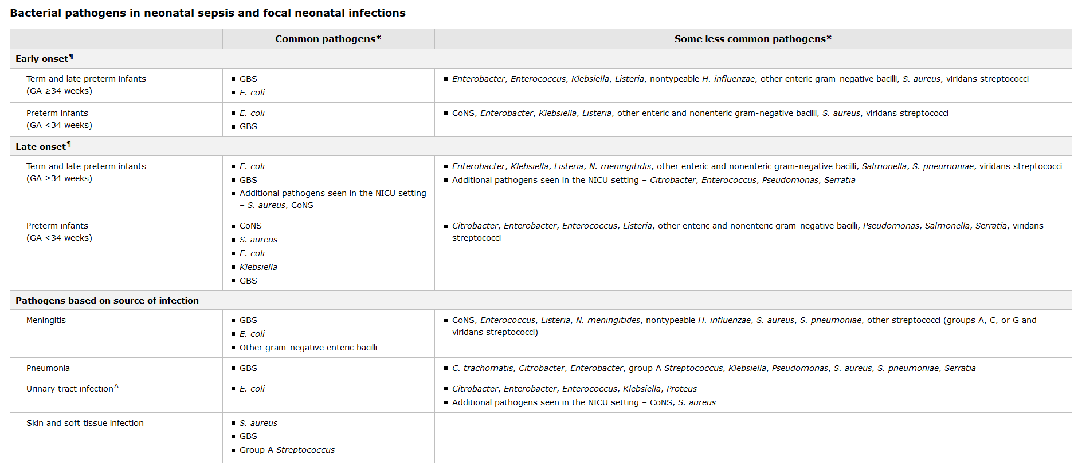

Slide 35
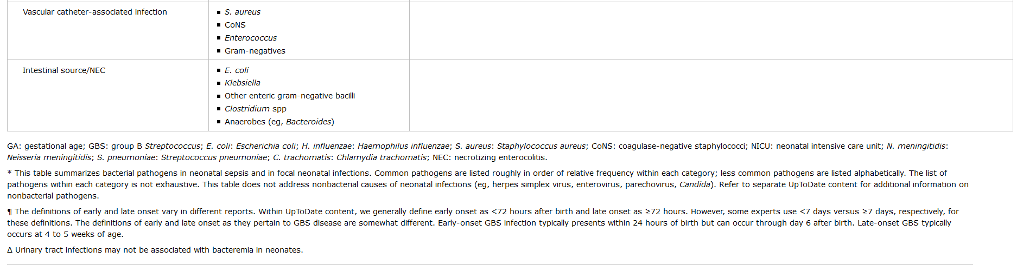

Slide 36
Clinical features
May be silent especially in premature newborn
Symptoms signs are usually non specific
→feeding intolerance & failure to suck
→lethargy and unresponsiveness
→tachypnea and apneic episodes
→grunting and other signs of RD ,etc
SxSx may vary with time of infection, infecting organism and organ(s) affected.
Notes:
Because the signs and symptoms of sepsis can be subtle and nonspecific, it is important to identify neonates with risk factors for sepsis and to have a high index of suspicion for sepsis when a newborn deviates from their usual pattern of activity or feeding
Systemic Inflammatory Response Syndrome
The clinical manifestations of infection depend on the virulence of the infecting organism and the body's inflammatory response. The term systemic
inflammatory response syndrome (SIRS) is most frequently used to describe this unique process of infection and the subsequent systemic response.

Slide 37
Clinical manifestations of bacterial sepsis
GENERAL:-
GASTROINTESTINAL SYSTEM:-
Fever,
temperature instability
“Not doing well”
Poor feeding
Edema
Abdominal distention
Vomiting
Diarrhea
Hepatomegaly
Notes:
Definition of Fever
“Gold Standard” is generally thought of as 100.4 (38.0) rectally with a glass mercury thermometer
Lots of ways to take a baby’s temperature
I recommend using a quality thermometer
When in doubt, let the pros sort it out
In Newborn Nursery, need to counsel parents about significance of fever in neonate

Slide 38
Conti…
RESPIRATORY SYTEM:-
CARDIOVASCULAR SYSTEM:-
Apnea, dyspnea
Tachypnea,
retractions
Flaring, grunting
Cyanosis
Pallor; mottling;
cold, clammy skin
Tachycardia
Hypotension
Bradycardia

Slide 39
Conti…
CENTRAL NERVOUS SYSTEM:-
HEMATOLOGIC SYSTEM:-
Irritability, lethargy
Tremors, seizures
Hyporeflexia, hypotonia
Abnormal Moro reflex
Irregular respirations
Full fontanel
High-pitched cry
Jaundice
Splenomegaly
Pallor
Petechiae, purpura
Bleeding

Slide 40
Investigations
Because of the high mortality rates, there must be a high index of suspicion for neonatal sepsis. Therefore, the following tests, known as septic workup, are done before antibiotics started.
Notes:
An immature-to-total phagocyte count (I/T ratio) (≥0.2) has the best sensitivity of the neutrophil indices for predicting neonatal sepsis. After the newborn period, serum C-reactive protein (CRP) and procalcitonin have demonstrated reasonable sensitivity and specificity for SBI. CRP may be monitored in newborn infants to assess response to therapy. T

Slide 41
Conti…
1.CBC:-The WBC and ANC are most predictive of infection when these values were low
(WBC < 5,000 and ANC <1,000). ,,,, elevated WBC (>20,000)
=> The combination of low ANC and elevated I/T ratio ( ≥0.2) is the most predictive combination of WBC indices for EOS.
=>thrombocytopenia & anemia suggests DIC
2.CXR
=>in patients with suspected to have pneumonia
3.Urine analysis & culture
4. Blood culture …. Gold standard
5.Acute phase reactant
Notes:
An elevated WBC (.20,000) is neither worrisome nor reassuring in neonates.
Other inflammatory markers — A number of acute phase reactants have been used to identify infected newborns. Many of these tests have acceptable sensitivity; however, they all lack specificity, resulting in poor positive predictive value [52]. No single biomarker or panel of screening tests is sufficiently sensitive to reliably detect neonatal sepsis [53].
●C-reactive protein (CRP) – CRP is increased in inflammatory conditions, including sepsis. A variety of noninfectious inflammatory conditions can also cause elevated CRP, including maternal fever, fetal distress, stressful delivery, perinatal asphyxia, meconium aspiration, and intraventricular hemorrhage [54].
A single measurement of CRP is not a useful aid in the diagnosis of neonatal sepsis, because it lacks sufficient sensitivity and specificity [55]. However, sequential assessment of CRP values may help to exclude the diagnosis of sepsis. If the CRP level remains persistently normal (<1 mg/dL [10 mg/L]), bacterial sepsis is unlikely [4].
CRP levels may be helpful in guiding the duration of antibiotic therapy in suspected neonatal bacterial infection. Neonates with elevated CRP levels that decrease to <1 mg/dL (10 mg/L) 24 to 48 hours after initiation of antibiotic therapy typically are not infected and generally do not require further antibiotic treatment if cultures are negative. However, we do not routinely use serial CRP measurements for this purpose since this practice appears to be associated with longer length of hospital stay [56].
An elevated CRP level alone does not justify continuation of empiric antibiotics for more than 36 to 48 hours in well-appearing neonates with negative culture results [57]. Additional evaluation may be warranted to investigate alternative explanations for persistently elevated CRP values.
●Procalcitonin (PCT) – PCT is the peptide precursor of calcitonin. It is released by parenchymal cells in response to bacterial toxins, leading to elevated serum levels in patients with bacterial infections. Several observational studies have suggested that elevated PCT levels are associated with infection in neonates [58-60]. In a systematic review of 18 studies, the sensitivity of PCT for detecting neonatal sepsis ranged from 72 to 79 percent, and the specificity ranged from 72 to 90 percent [60]. Thus, although PCT is a promising marker, it does not appear to be reliable as the sole or main diagnostic indicator for neonatal sepsis.
A randomized clinical trial suggested that adding serial PCT measurements to other standard assessments (ie, clinical examination and culture results) may shorten duration of antibiotic therapy [61]. However, in this trial, the treating clinicians overruled the study protocol's suggested duration of antibiotic therapy in >40 percent of the enrolled neonates, which limits the certainty of the study's findings. Additional data are needed before monitoring PCT levels can be adopted into routine neonatal clinical practice. If PCT levels are obtained, they should be used in conjunction with other clinical indicators of sepsis and should not be the sole basis of decision-making.

Slide 42
Conti…
6.CSF analysis:-in suspected neonatal meningitis
➔abnormal finding suggesting meningitis
a. WBC>30/mm3 with >60% polymorphs
b. protein level >150mg/dl in terms & >175mg/dl in preterms
c. CSF glucose <50% of serum glucose
d. positive gram stain & culture.
Notes:
Neutrophil counts — Both the absolute neutrophil and the ratio of immature to total neutrophil counts (I/T ratio) have been used as markers for neonatal sepsis. However, as is true for term and late preterm infants, these tests are not useful to accurately predict neonatal sepsis. (See "Clinical features, evaluation, and diagnosis of sepsis in term and late preterm neonates", section on 'Complete blood count'.)
This was illustrated in a multicenter study of 166,092 infants that included both term and preterm infants with a mean gestational age of 34.6 weeks who were suspected to have early-onset sepsis (EOS) [38]. Although the probability of a positive blood culture within the first three days of age increased with a low white blood cell count (<5000/microL), absolute neutropenia (<1000 neutrophils/microL), and an elevated I/T ratio, sensitivities of all indices were poor and insufficient to accurately diagnose neonatal sepsis.
In another analysis of the same cohort of patients, late-onset sepsis (LOS; defined as a positive culture between day of age 4 and 120) was associated with both low and high white blood cell counts (<1000 and >50,000/microL), high absolute neutrophil count (>17,670/microL), elevated I/T ratio of 0.2 or higher, and low platelet count (<50,000/microL) [38]. However, sensitivity also was inadequate to reliably make the diagnosis of LOS.
C-reactive protein — CRP is an acute phase reactant synthesized in the liver that increases in inflammatory conditions, including sepsis. Although an elevated CRP greater than 1 mg/dL is 90 percent sensitive in detecting neonatal sepsis, its poor specificity makes it a poor predictor for neonatal sepsis as it is elevated in other noninfectious inflammatory conditions (eg, maternal fever, fetal distress) [39]. CRP levels do not seem to be affected by gestational age [40], and serial CRPs have been found to be useful to follow resolution of infection and guide antibiotic therapy

Slide 43
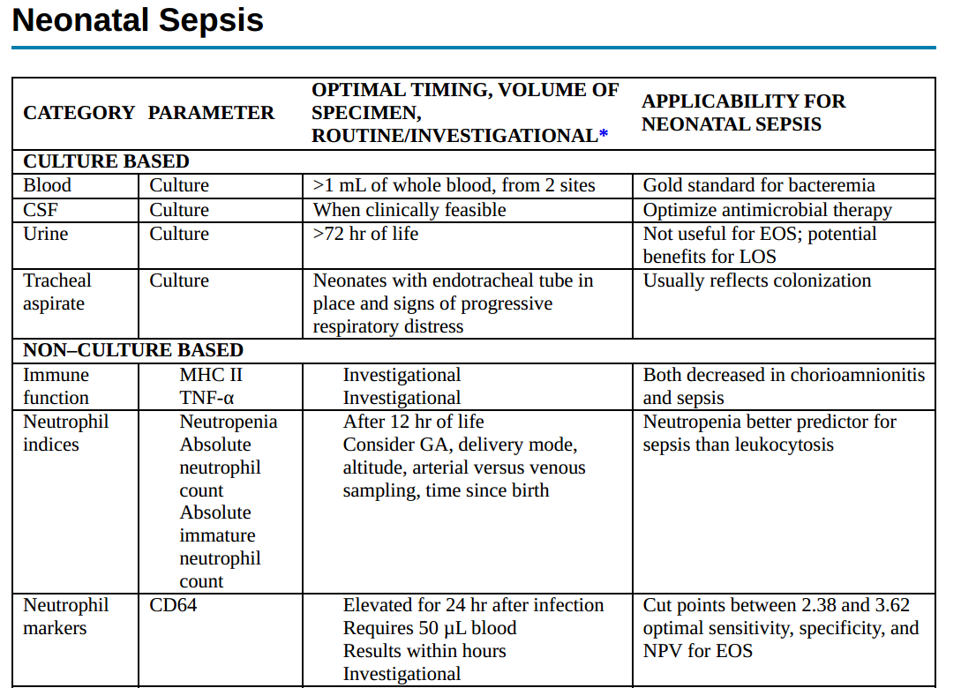

Slide 44
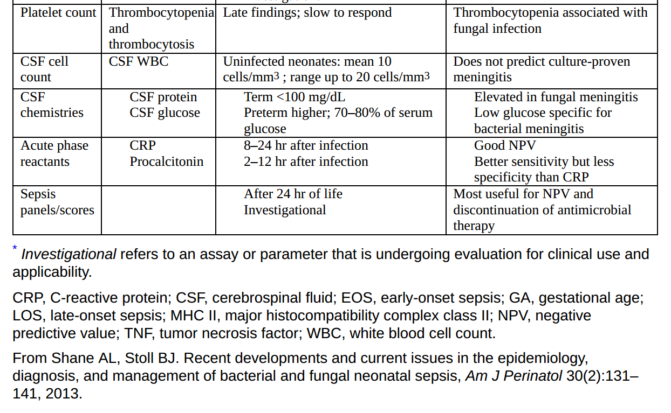
Notes:
Investigations
CBC with Diff
Immature:mature ratio (> 0.2)
Gastric aspirate for plymorphs within 1hr of age (> 5PMNs/HPF)
CRP
Micro-ESR
U/A
Culture (blood,CSF,urine)
CXR
Antigen detection (GBS, Pneumococcus)

Slide 45
Management of bacterial infections
Supportive (O2,Iv fluid, NGT)
Antibiotic-depends on etiology and site of infection
  Sepsis without meningitis
    Suspected : Ampicillin(100mg/kg/day + Gentamycin (3-5mg/kg/day) for7-10days
    G+ve bacteria: 7-10days (Im/IV)
    G-ve bacteria: 10-14days (Im/IV)

Slide 46
Conti…
Meningitis:
  G+ve bacteria: high dose Ampicillin + cephalosporine for 14-21days,IV
  Double the dose of antibiotics
  G-ve bacteria: for 21days (IV)

Slide 47
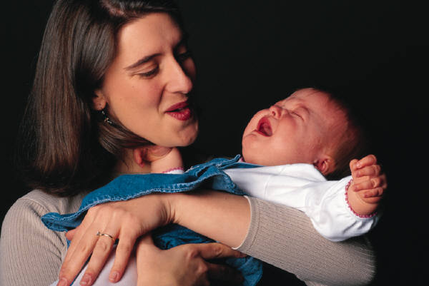
GOOD DAY!!

Slide 48
References
Nelson Textbook of Pediatrics 21st Edition .
Cloherty and Stark's manual of neonatal care 9th edition(2021).
Fanaroff & Martin’s Neonatal-Perinatal Medicine diseases of the fetus and infant 11th Edition.
UpToDate 2023
Gomella’s Neonatology 8th Edition (2020).

